Slide 1
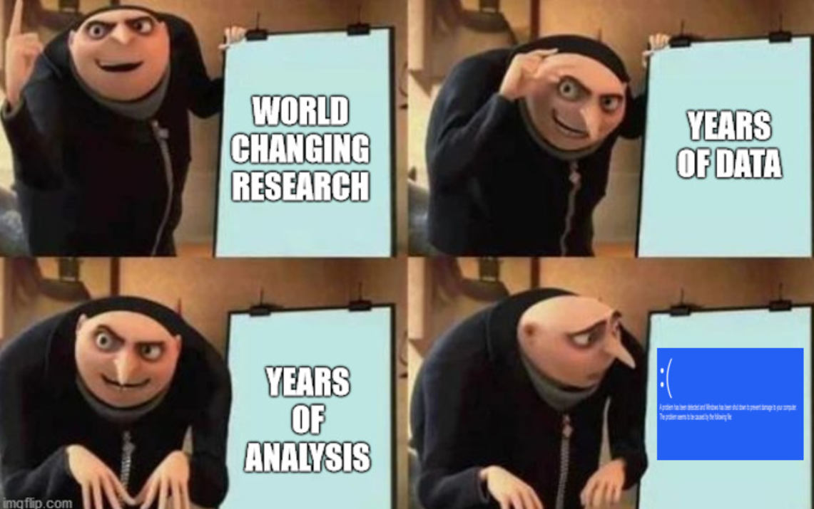
Intro to Research Data Management (RDM)
source
Nick Rochlin, Data Science Librarian
UVic Libraries

Slide 2
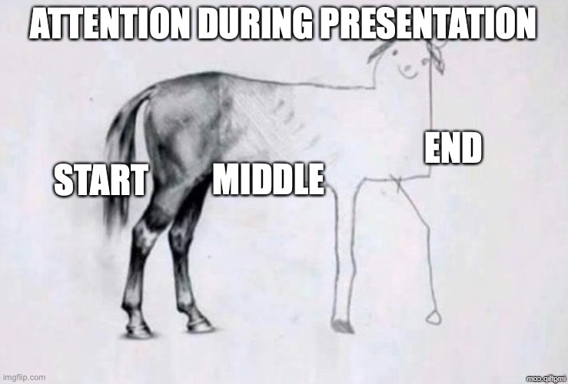
Session Overview
What is research data management (RDM)?
Why should you care? (Should you?)
Uvic’s RDM Services
source

Slide 3

What is Research Data Management (RDM)?
source

Slide 4
What Are Research Data?

Slide 5
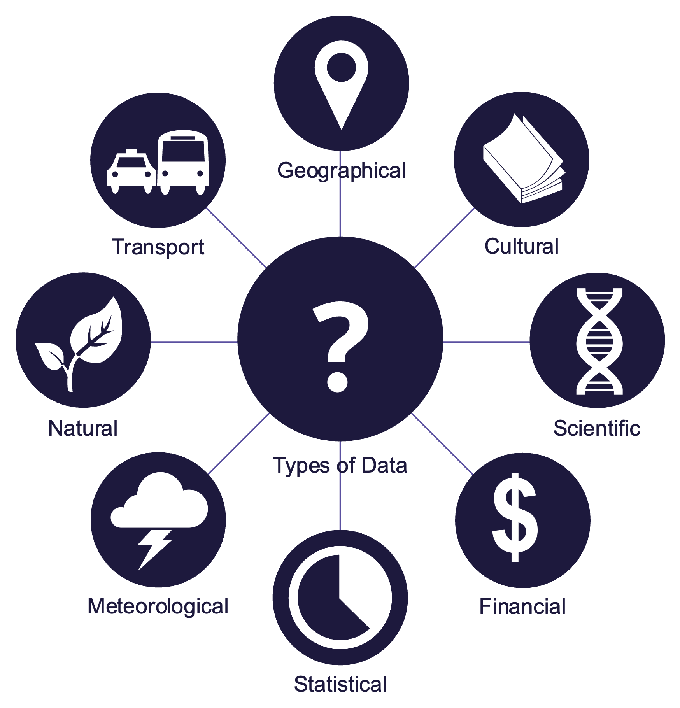
What Are Research Data?
“Research data are used as primary sources or evidence to support and validate an inquiry, research question(s), and/or creative work.
Research data are distinguished by their intended purpose rather than form and can be experimental, observational, repurposed, processed, or any other manifestation of data. Determining what constitutes research data can be highly contextual and should be decided in keeping with disciplinary norms.”
source

Slide 6
What is RDM?
source

Slide 7
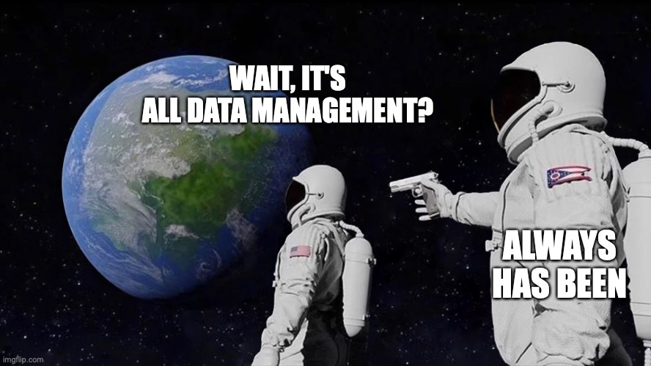
What is RDM?
“RDM are practices and activities over the research life cycle that pertain to the management of research data, including planning, collecting, analyzing, documenting, storing, sharing, and preserving.
RDM is essential at all points of a data’s lifecycle and should be a fundamental part of any project's design and progression.”
source
source

Slide 8
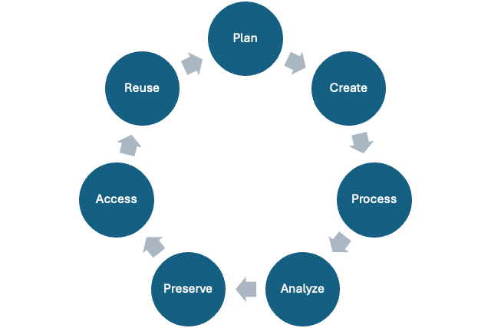
The Research Data Lifecycle

Slide 9
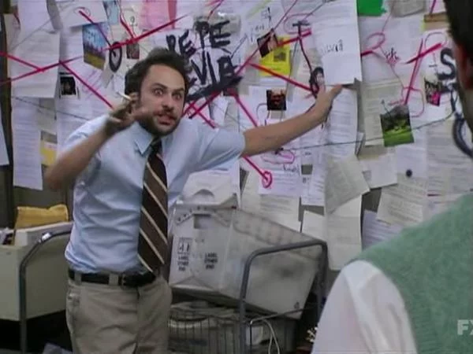
The Research Data Lifecycle
source

Slide 10

Why Should You Care? (Should you?)
source

Slide 11
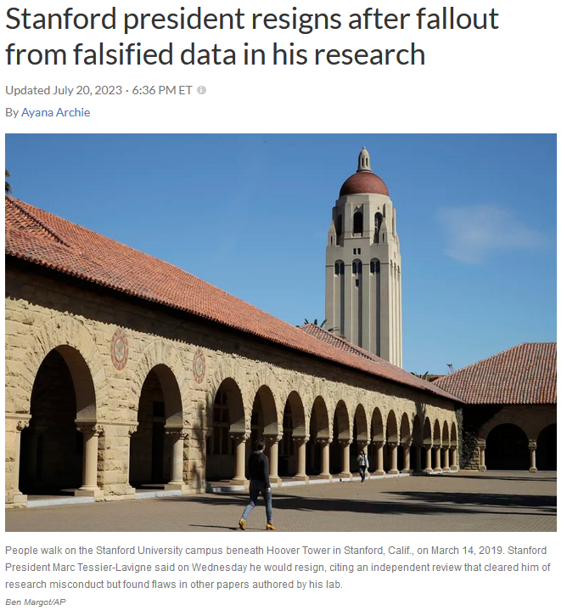
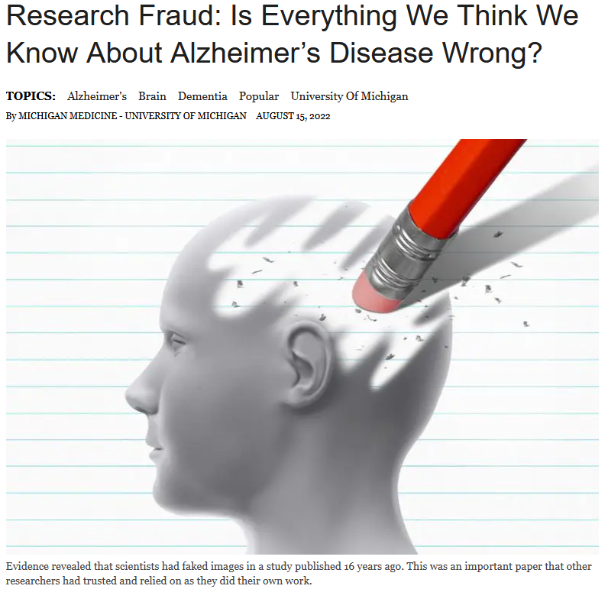
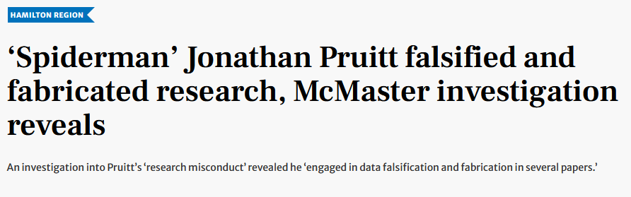
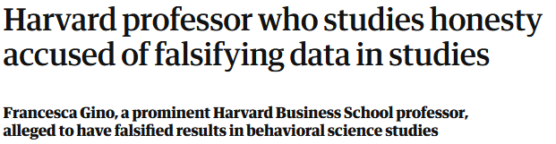
Academic Integrity
source
source
source
source

Slide 12



Tri-Agency Policy
Researchers:
Data Management Plans
Have started piloting with a handful of grants, more to come
Data Deposits
Will phase in based on readiness of community
source

Slide 13
Tri-Agency Policy
Institutions
Institutional Strategy
(Most) published March 1, 2023
source

Slide 14
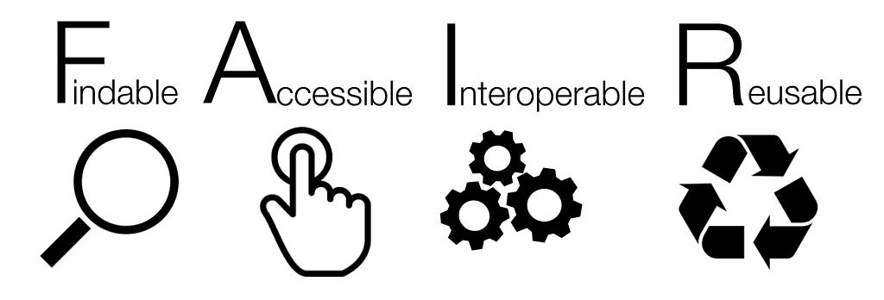
FAIR Principles
source

Slide 15
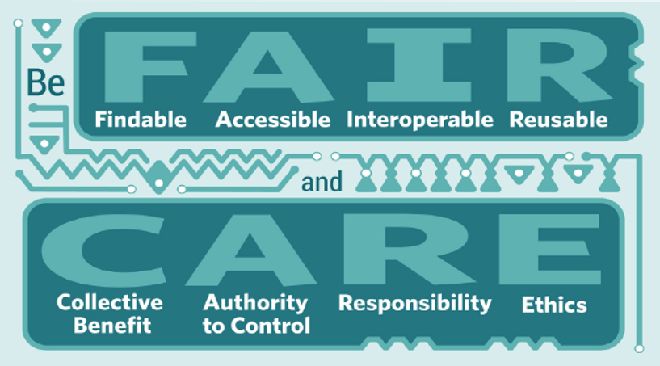
CARE Principles
source

Slide 16
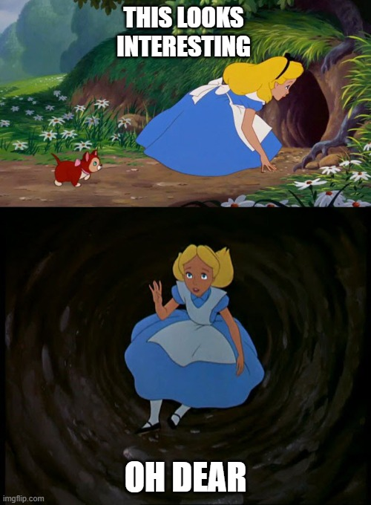
Legal, Copyright, & Ethics
source

Slide 17
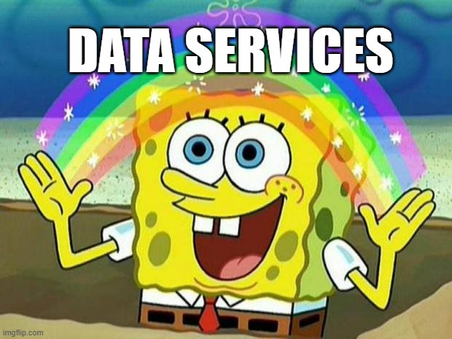
UVic’s RDM Services
source

Slide 18
Data Management Plans (DMPs)
UVic DMP Assistant template
1:1 guidance to complete DMPs
DMP workshops

Slide 19
Data Deposits
UVic’s Borealis repository
Provide 1:1 support to navigate deposits
Detailed curation process to ensure that data and code are FAIR
CoreTrustSeal certified as a Trustworthy Data Repository
Support for finding and depositing data in other repositories, if needed

Slide 20
Other Cool Stuff
File/folder naming and data organization via consultations and workshops
Metadata schemas and controlled vocabularies
Data analysis and reproducibility
Data licensing
Sensitive data
Connecting researchers with other data services (storage, compute, funding requirements)
Grants menu

Slide 21
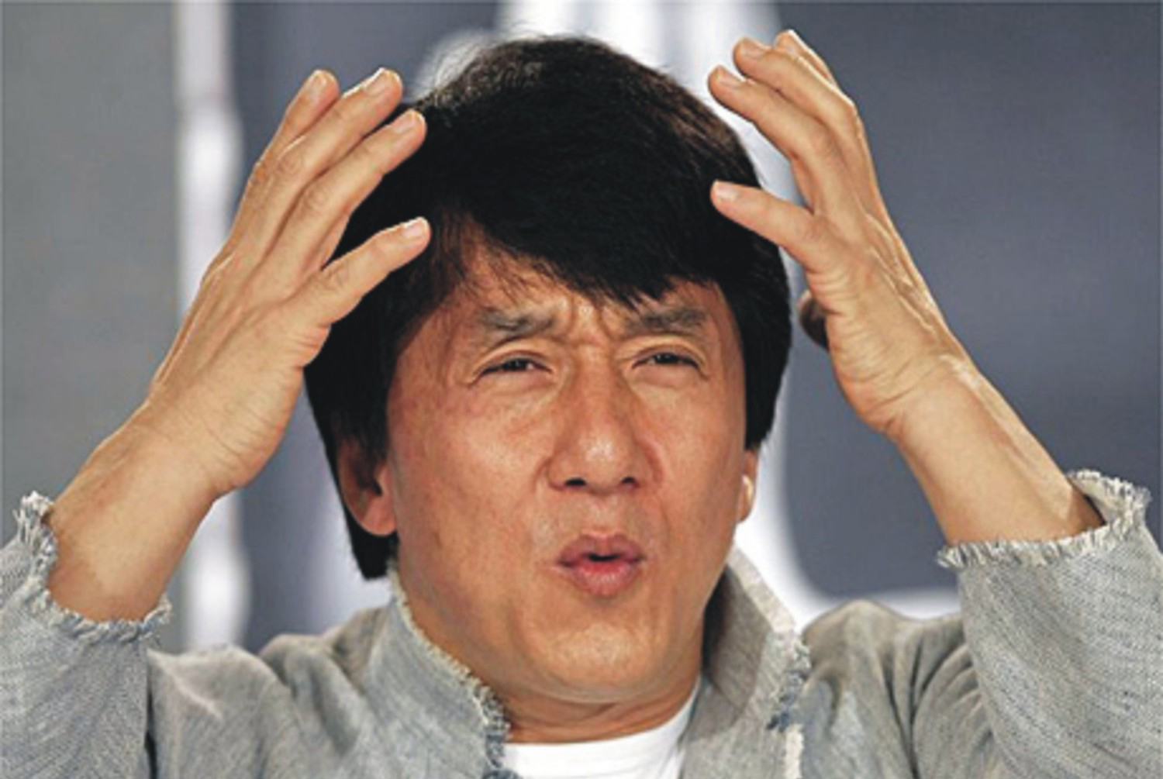
Questions?
source

